Slide 1
Terminology Translation
Mapping Clinical and Administrative Codes
Lloyd McKenzie, P.Eng HL7 Da Vinci Project Deputy Technical Director, CRD IG Lead, and Chief Standards Officer, Dogwood Health Consulting
Denis Casaubon Product Management Director, American Medical Association (AMA)
Robert Dieterle HL7 Da Vinci Project Sr. Advisor and Burden Reduction Lead, and CEO, EnableCare Group

Slide 2
Issue
CRD triggers off clinical orders and appointments
DTR populates using clinical data
Data will often exist with clinical codes, not billing codes
E.g. SNOMED CT, rather than CPT or ICD10
Payers will need to make coverage decisions based on this clinical data
Payer engines are set up to use billing codes
Mapping will thus be needed

Slide 3
Additional Considerations
Even if a billing code (e.g. CPT is present), mapping may still be needed
E.g. an order for a “Head CT” could be billed as “Head CT with Contrast”
Code systems continue to evolve
Mappings need to be based on “how is this likely to be billed”
Many of the code systems involved are ‘large’
With SNOMED CT post-coordination, near-infinite
Don’t need maps for “all concepts” – only those relevant to the coverage
Sometimes mapping won’t be possible (e.g. text)

Slide 4
Tools and supports

Slide 5
ConceptMap
Standard FHIR resource
Can be put in a searchable registry
Allows computable exchange of how one set of codes maps to another set
Allows capturing the nature of the relationship
Equivalent, broader than, narrower than, not mappable
E.g.
SNOMED CT 396207002 (CT brain with contrast) = CPT 70460 (Brain CT w/ Contrast)
SNOMED CT 446459005 (CT of brain perfusion using xenon) < CPT 70460 (Brain CT w/ Contrast)

Slide 6
Terminology services
Can handle navigating post-coordination and specialization hierarchies
E.g. SNOMED CT
1290563003:405813007=62413002:272741003= 7771000 (Plain X-ray of forearm, anteroposterior and lateral views : Procedure site – direct = Radius : laterality = left) can be generalized to SNOMED CT:
783544001 (Plain X-ray of forearm)
Which can then be mapped to CPT code 73090 (Diagnostic Radiology (Diagnostic Imaging) Procedures of the Upper Extremities)

Slide 7
Terminology services calls
$translate
Pass in a code and a target code system
Get back a matching code (or set of codes)
$subsumes
Checks if one code is a proper specialization of another
$expand
Allows finding all codes that are specializations or generalizations of another
There are both commercial and open-source terminology services implementations available

Slide 8
Available Terminology Services
https://github.com/HealthIntersections/fhirserver
https://github.com/IHTSDO/snowstorm
https://gitlab.com/elga-gmbh/termgit
https://hapifhir.io/hapi-fhir/docs/server_jpa/terminology.html
https://ontoserver.csiro.au/site
https://openconceptlab.org
https://termx.org

Slide 9
Translation challenges
Most translations aren’t exact
There may be some candidate codes that aren’t appropriate
There may be a lot of candidate codes
CRD allows returning different responses and indicating which billing codes a given response applies to
If there are too many codes, ok to say a more specific code is needed
With DTR, you can choose to populate with the ‘closest’ code, or not populate
Whichever you feel is safest and most useful to the user filling the form

Slide 10
Status of the AMA Terminology Mapping
Denis Casaubon, MBA
Product Management Director
Health Solutions

Slide 11
Maps Overview

Slide 12
SNOMED CT® to CPT® Map Scope
Maps SNOMED CT concepts (used in clinical documentation) to CPT codes (used for prior authorization, billing, public health reporting, etc.)
Intended as a resource that can be refined for various use cases and users
Includes:
International and U.S. Editions of SNOMED CT
Concepts in the SNOMED CT Procedure (procedure) hierarchy
Excludes inactive concepts
Other minor exclusions (e.g., 12 concepts in Staff related procedure (procedure) hierarchy)
Annual release schedule has included the September U.S. Edition release
SNOMED CT® is a registered trademark of SNOMED International.

Slide 13
SNOMED CT® to CPT® Map Foundation (2023)
Category | General Rule
41 | Fully classified mapping. CPT code is exact match OR more general than SNOMED CT concept.
42 | CPT code includes “(separate procedure)” annotation.
53 | CPT code is not exact match, AND not more general than SNOMED CT concept AND not an Evaluation and Management (E/M) code AND does not include “(separate procedure)” annotation.
54 | CPT code is an E/M code, including add-on E/M codes, AND more granular than the SNOMED CT concept.
55 | CPT code is not an E/M code AND includes “(List separately in addition to code for primary procedure)” annotation. (To Fully classify may require additional information).
60 | CPT code is an Unlisted procedure (ULP) because no specific CPT code exists. SNOMED CT concept meets criteria for specificity, (e.g., anatomical site, method, approach), but there is no candidate CPT code available.
0 | Unmappable. SNOMED CT concept has insufficient information (e.g., anatomical site, method, approach, granularity of subtypes) to identify a target CPT code.

Slide 14
Example Mapping Results
SNOMED CT®
CATEGORY
CPT® Code
Pharyngoplasty for cleft palate (procedure)
249848005
41
42950
Pharyngoplasty (plastic or reconstructive operation on pharynx)
53
42200
Palatoplasty for cleft palate, soft and/or hard palate only
53
42205
Palatoplasty for cleft palate, with closure of alveolar ridge; soft tissue only
53
42210
Palatoplasty for cleft palate, with closure of alveolar ridge; with bone graft to alveolar ridge (includes obtaining graft)
60
42999
Unlisted procedure, pharynx, adenoids, or tonsils

Slide 15
Example Mapping Results
SNOMED CT®
CATEGORY
CPT® Code
Pharyngoplasty for cleft palate (procedure)
249848005
41
42950
Pharyngoplasty (plastic or reconstructive operation on pharynx)
1 to Many
53
42200
Palatoplasty for cleft palate, soft and/or hard palate only
53
42205
Palatoplasty for cleft palate, with closure of alveolar ridge; soft tissue only
53
42210
Palatoplasty for cleft palate, with closure of alveolar ridge; with bone graft to alveolar ridge (includes obtaining graft)
Nuanced rules if needed
60
42999
Unlisted procedure, pharynx, adenoids, or tonsils
Notes:
What also may be helpful is mapping CPT codes to areas-Other AMA products have hierarchy and various data attributes that help organize and navigate to informed code selection

Slide 16
Mapping by Categories (Approximate breakdown from 2023)

Slide 17
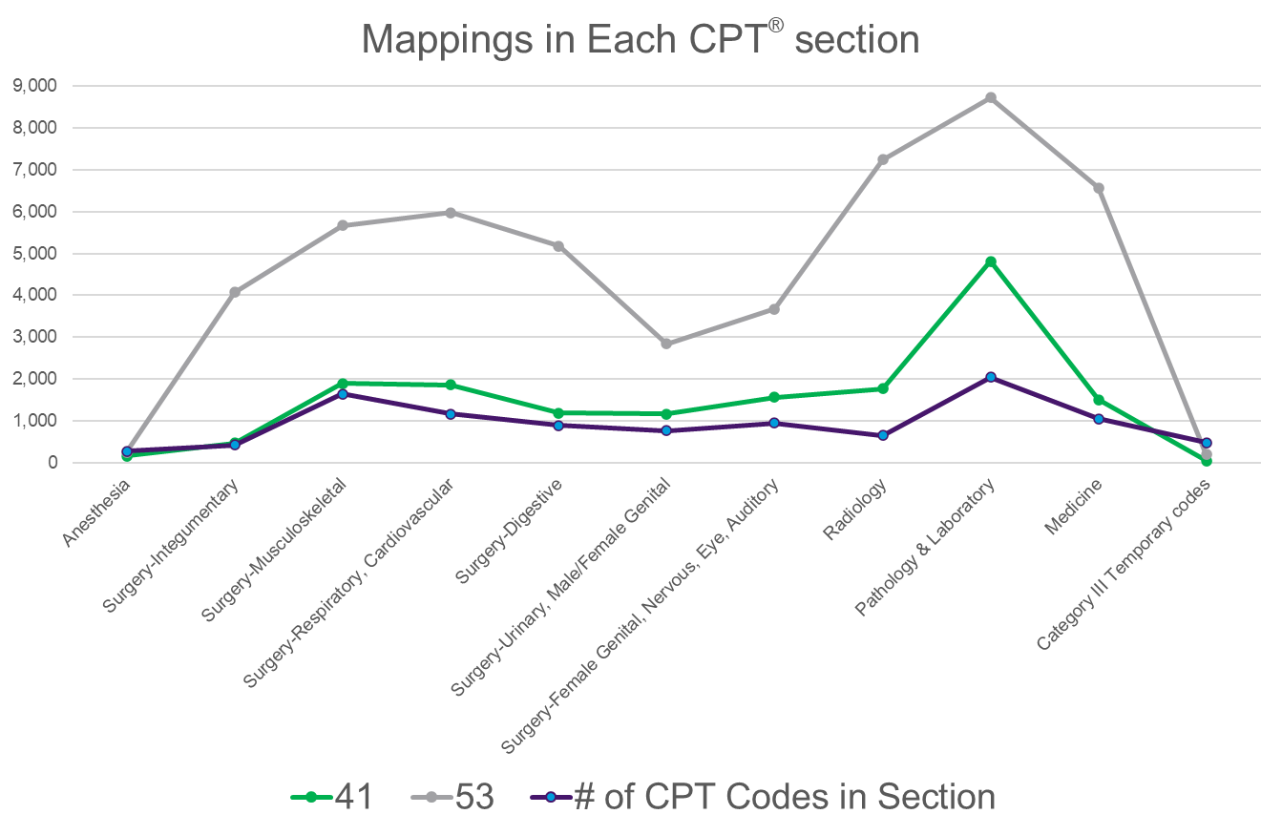
Mapping Compared to Prior Auth Volume
Most codes used in PA
E/M, MSK, Surgery, DMEPOS (HCPCS) .
Codes with highest UM
Mental health, Sleep, Lab
*Source: 2023 Cohere Benchmark report
Notes:
1035 E/M maps for 157 codes

Slide 18
Map Availability

Slide 19
Map Availability
Update status
Format
Maintenance
Licensing
The last update took place in January 2023 and maps typically change ~5% per year.
The AMA is evaluating viability of map scope and rules before the next update.

Slide 20
Map Availability
Currently in xls and txt files, with a JSON API testing endpoint.
Better insight into workflows will drive maps format:
Files loaded in a system
JSON API to update systems or query on demand
HL7® FHIR® standard resource to map codes in flight
Update status
Format
Maintenance
Licensing
HL7, FHIR and the FHIR [FLAME DESIGN] are the registered trademarks of Health Level Seven International and their use does not constitute endorsement by HL7.

Slide 21
Map Availability
Update status
Format
Maintenance
Licensing
Maps were previously updated annually; the AMA is soliciting input for required frequency.
U.S. Edition of SNOMED CT® is released twice annually
CPT® codes have a main release annually plus quarterly updates (primarily PLA codes)

Slide 22
Map Availability
Maps are currently not available to license.
The AMA is working on a testing agreement for the short term and evaluating license agreement terms for future use.
Update status
Format
Maintenance
Licensing
Notes:
Outstanding Workflow Questions
What level of SNOMED concepts is likely to be mapped?
Sensitivity vs specificity in results – multiple outputs that capture the full range of possibilities or one code that may not be what’s billed?

Slide 23
Questions?
For Map questions or interest in testing, reach out to Denis Casaubon, denis.casaubon@ama-assn.org

Slide 25
Other Mapping Strategies

Slide 26
EHRs can Provide Mappings
Sometimes the EHR knows how something will likely be billed
i.e. an internal order
CRD allows (but does not require) the CRD client to provide billing code translations
Change coming soon to allow sending multiple candidate billing codes
Payers can leverage this if available, but cannot require this to be present
In many cases, the ordering clinician has no clue how it’ll be billed

Slide 27
Translating using payer data
The best source of clinical -> billing codes is/will be payers
Payers know what billing codes are used
and who uses what
Payers may have access to clinical order codes now
submitted attachments
quality metric information
audit checks
Etc.
Going forward, payers will have access to clinical order codes from CRD
Payers can learn what clinical order codes typically result in which billing codes
Possibly with context
ordering provider, performing facility, etc.

Slide 28
Summing Up

Slide 29
Key Messages
Code translation will be necessary for both CRD & DTR
Code translation is complex and has challenges
Work on your strategy early…
There are common tools and structures to share the work
AMA has initial SNOMED to CPT and CPT to CPT capabilities that may be helpful
Over time, payers will have the knowledge to make their mappings better
At some point, administrative systems need operate off clinical terminologies rather than separate terminologies that do not accurately reflect patient care needs

Slide 30
Questions?

